Slide 1
Who Are You, Arduino?
Er. Sahil Khanna
www.SahilKhanna.org

Slide 2
Well I am…
An open-source electronics prototyping
platform.
Ohkkay… Is this some kind of magic spell
or what?
Well what I mean to say is that all my information like
- How can I be made
- What I am made of
- What languages I understand etc.
Is all out in the open. I’m based on flexible, easy to use
Hardware and software. You can build me in your own home.
COOL… but am I capable enough to even use you?
If you are an artist, designer, hobbyist, or even someone interested in creating interactive objects or environments then I’m the one for you!

Slide 3
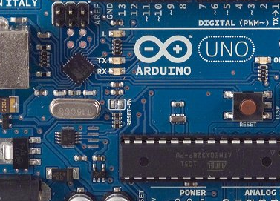
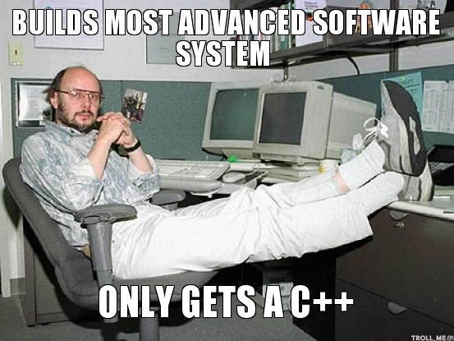
Please tell me more about you
Well, you can say I’m made of two parts
HARDWARE
SOFTWARE

Slide 4
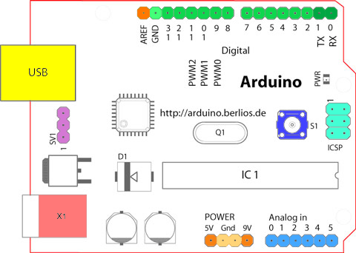
HARDWARE
Now don’t worry let me complete first.
I come in various shapes and sizes
Whoa! I’m scared!! How?? And Why??
I told you let me complete first. Although I have various version
But my thinking style is the same. I’ll tell you about it later, for now
just consider one of my version named Arduino UNO.
This is how I look like

Slide 5
HARDWARE
This is my USB
Port, it lets me
connect to your
Computer.
It also supplies me
power.
This is my Power
Port. It keeps me
Alive.

Slide 6
HARDWARE
These are Analog
Pins which let me
Sense Analog
Inputs from 0-5V.
These pins lets me power the circuit

Slide 7
HARDWARE
Reset Button for a refreshing
restart!
This is the main microcontroller
Chip which lets me think.

Slide 8
HARDWARE
These are 14 Digital IO Pins, i.e. they can sense as well as send Digital Signals.

Slide 9
HARDWARE
You can get more detailed information here
http://arduino.cc/en/Reference/Board

Slide 10
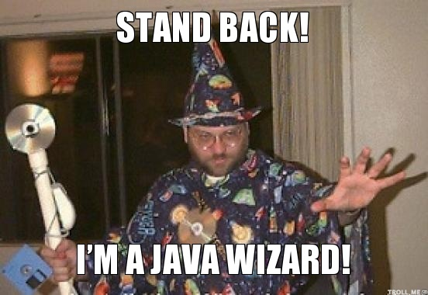
SOFTWARE
Well like most people communicate with
eachother via certain language like hindi, punjabi, english etc, I intearct with your computer via C/C++ derived language.
My IDE(integrated development environment) is a cross-platform
application.
Cross what?
Well it doesn’t matter if you have
a Mac, Windows or Linux, you can
program me anytime anywhere.
This is because it’s based on JAVA.
Download Software from here -
http://arduino.cc/en/Main/Software

Slide 11
SOFTWARE
Bare Minimum Code / Structure
BTW my program is not called a program.
It’s called a sketch(artsy right? ☺ ).

Slide 12
SOFTWARE
void setup()
This function runs once and only once, No question asked! It shoots up as soon as Arduino is powered ON.
Remember to use it to initialize variables, pin modes, start using libraries, etc.
#
It’s like when you plan for a trip
and you make a list of all the things
required for the trip.

Slide 13
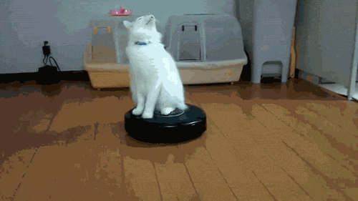
SOFTWARE
void loop()
This function runs again and again endlessly
to eternity (well not exactly but as Arduino has a life cycle).
And it makes sense too, as in each and every situation of our life the process keep on going again and again.

Slide 14
WHY ME?
because I’m….
Wide support for all
kinds of sensors
fast
cheap
Abundant Libraries
Open-Source
Cross-Platform
easy yet complex
and many more…

Slide 15
I think we have good understanding
right now
be geared up for more
for any doubts mail me at
mail@sahilkhanna.org
Aloha…

