Slide 1
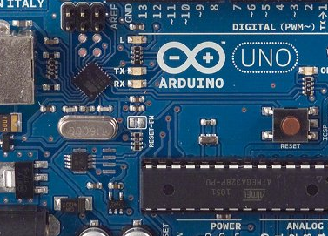
:Blink Blink:
Er. Sahil Khanna
www.SahilKhanna.org

Slide 2
It’s VIDEO time!

Slide 3
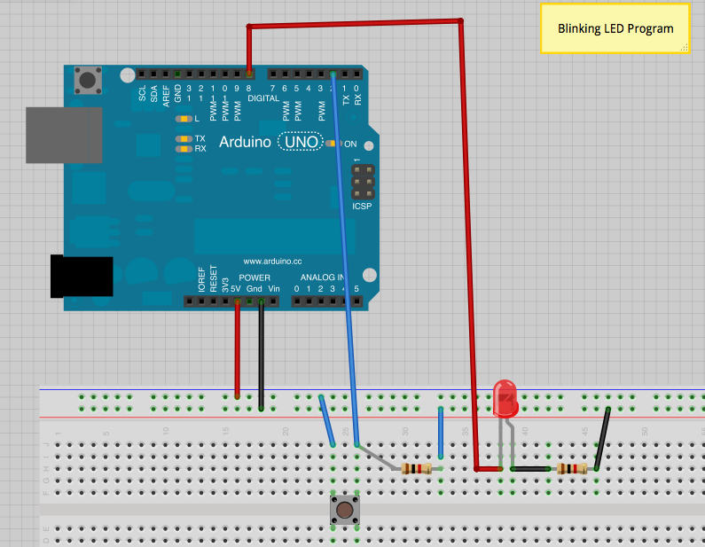
Circuit Diagram

Slide 4
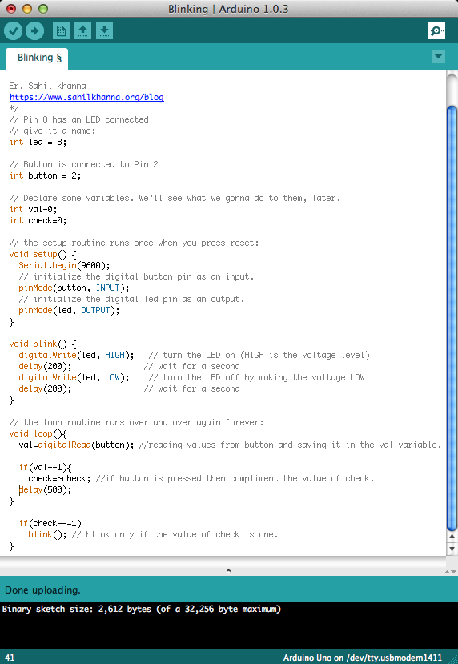
//Code
Download Link ->
www.sahilkhanna.org/blog/arduino-blink-program

Slide 5
Code Explantation
int led = 8;
Pin number of Arduino attached
to led.
Assigning a variable for pin 8
Nature of variable i.e. integer
// Button is connected to Pin 2
int button = 2;
// Declare some variables. We'll see what we gonna do to them, later.
int val=0;
int check=0;

Slide 6
Code Explantation
// the setup routine runs once when you press reset:
void setup() {
// initialize the digital button pin as an input.
pinMode(button, INPUT);
Setting what the pin(in this case the button)
will act as i.e. OUTPUT or INPUT.
As we will be reading the signal from the button, so we will assign it as an INPUT.
// initialize the digital led pin as an output.
pinMode(led, OUTPUT);
}
As we will be turning on the LED, so we will assign it as an OUTPUT.

Slide 7
Code Explantation
// the loop routine runs over and over again forever:
void loop(){
val=digitalRead(button); //reading values from button and saving it in the val variable.
if(val==1){
check=~check; //if button is pressed then
compliment the value of check.
delay(500); //wait for 0.5 seconds
}
if(check==1)
blink(); // blink only if the value of check is one.
}
This function helps us to read digital values from our “button” pin
and then save it in “val” integer.
Here we have used a custom made function to define the
blinking process. Lets see how it works.

Slide 8
Code Explantation
void blink() {
digitalWrite(led, HIGH); // turn the LED on (HIGH is the voltage level)
delay(200); // wait for a second
digitalWrite(led, LOW); // turn the LED off by making the voltage LOW
delay(200); // wait for a second
}
This function tells to make the given pin(in this case our LED) as
either HIGH(1 or 5V) or LOW(0 or 0V).
This function gives us a delay in milli seconds i.e. if we have given
1000 then the delay is 1 sec and if 200 then 0.2 seconds and so on.

Slide 9
What’s Happening?
Arduino is constantly checking the signal from the button(which is fed into val).
Whenever the button(val = 1) is pressed it compliments the value of check variable.
When the value of check becomes 1, our arduino starts the blinking process.

Slide 10
Congratulations,
You have just made your first Arduino
code.
Give yourself a pat
on the back. You
did great!
for any doubts mail me at
mail@sahilkhanna.org
or find me here ->
https://facebook.com/sahilkhanna
Aloha…

